Slide 1

Leaf Detection

Slide 2
Introduction
In Digital Image Processing massive development has been made in this era. It is used for medical field, pattern recognition, remote sensing, agriculture field and etc. In this project, we have implemented our system to detect plant leaves on the basis of their shapes by using digital image processing techniques.
Therefore, we have collected different type of leaf images with various shapes which have at least 10 images in each type. Here we used more images to increase the accuracy of the system. Initially we designed a Graphical User Interface(GUI) with buttons and axis by using MATLAB to perform our functions in the system. So, user can able to detect the plant leaf’s name by using this system.

Slide 3
Aims/Objectives
Our main objective is to develop a system which gives users the ability to identify plant leaves on the basis of their shapes by using Digital Image Processing techniques.

Slide 4
Functional Requirements
Design Graphical User Interface(GUI)
Select an image from dataset
Resize the image
Perform the noise removal
Remove shadow from the image
Convert image from RGB to Black & White
Train the images to recognize their shapes
Reset image from GUI to train the other image
Test image to detect leaf’s name

Slide 5
Methodology
Data Collection
Design GUI
Select an Image
Pre- Processing
Convert to B&W
Pre- Processing
Convert to B&W
Train the image
Resize the Image
Noise Removal
Shadow Removal
Test the image

Slide 6
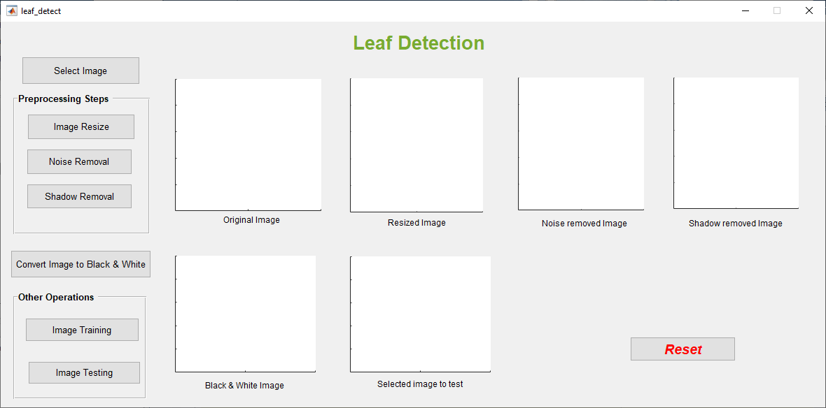
The purpose of this GUI is to perform the functions to detect leaves.

Slide 7
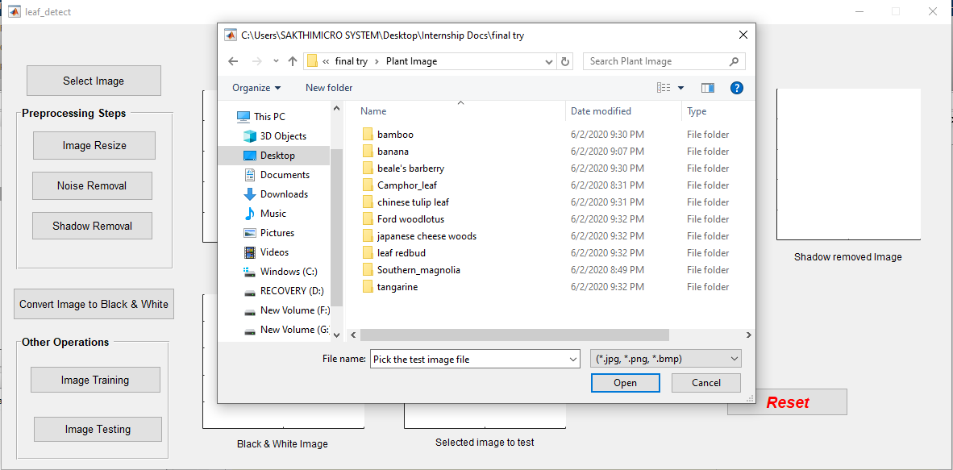
User can able to select an image from dataset by using this select image button as shown below.

Slide 8
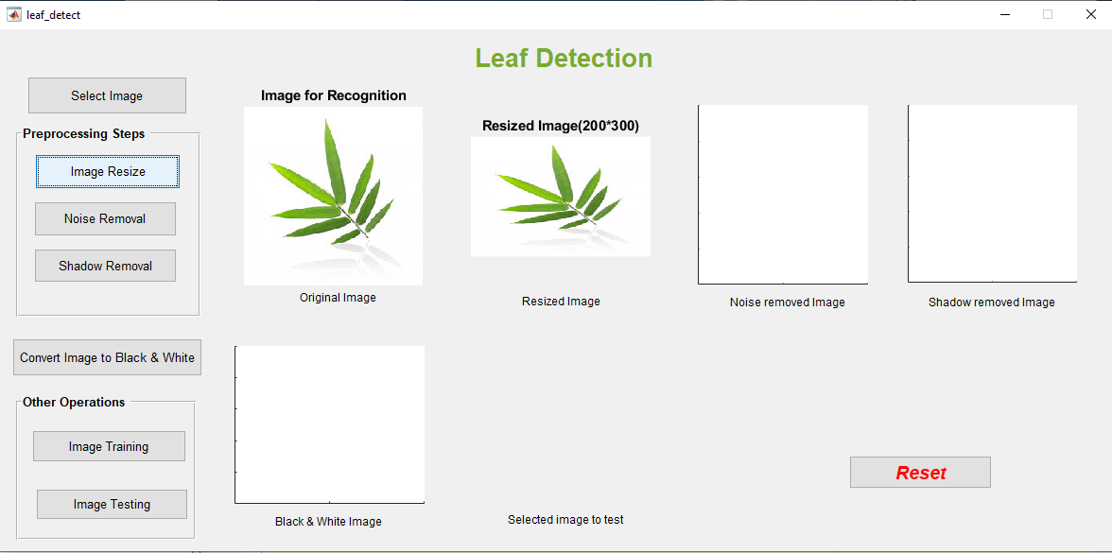
This interface shows that user should resize the original image from existing axis to other axis.

Slide 9
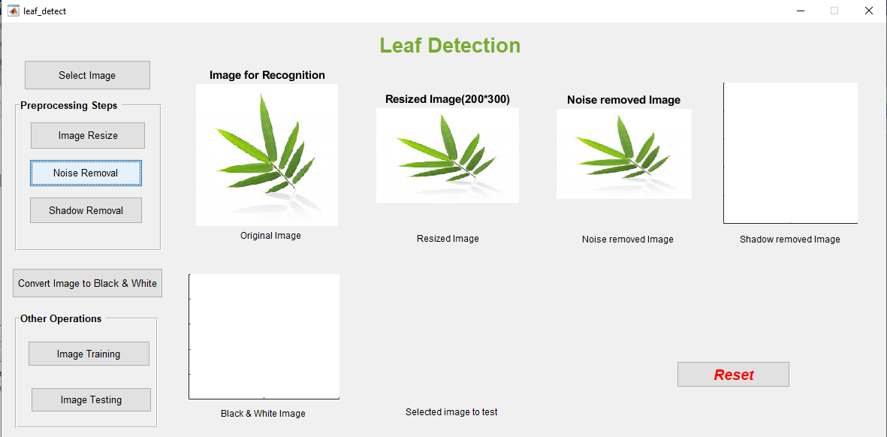
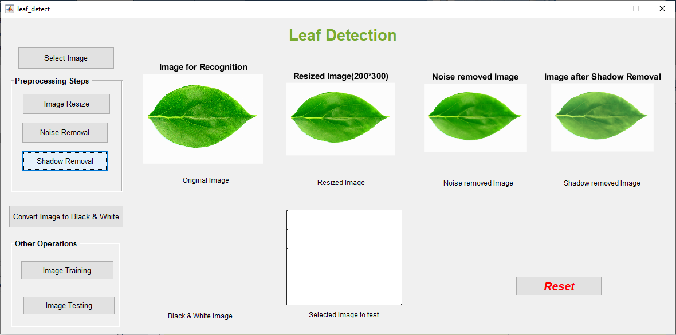
User can remove noise & shadow from original image by using this pre-processing steps.

Slide 10
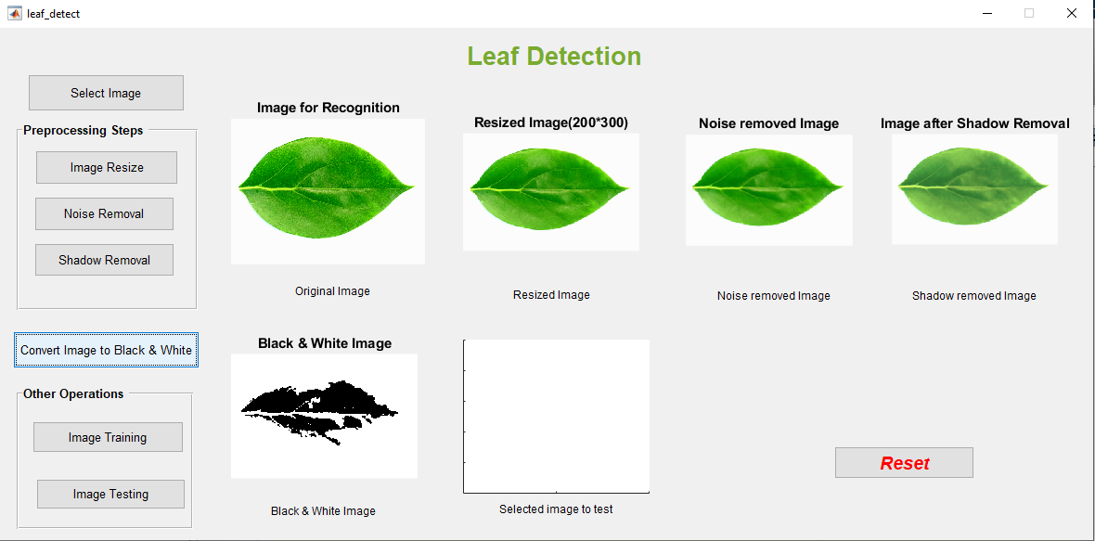
Convert image from RGB to Black & White to train the image.

Slide 11
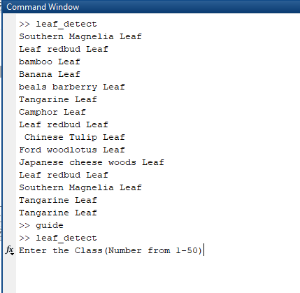
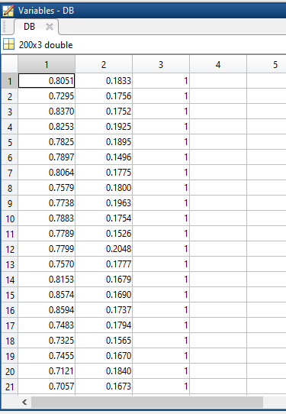
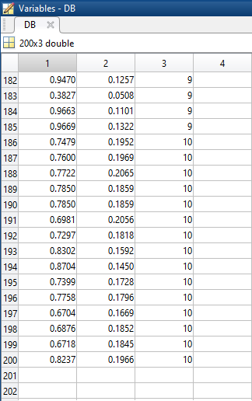
By using this training image step, user can able to classify the images for different classes by defining the numbers for each class with leaf’s names. Then each class will be stored into database with values in 3 columns.

Slide 12
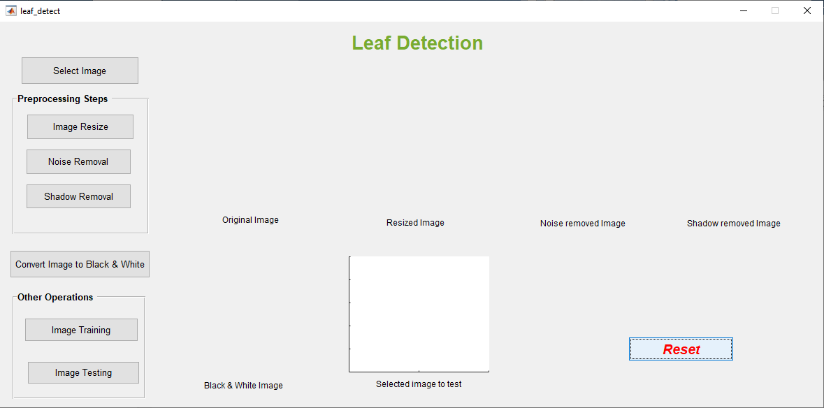
Reset button helps to remove images from axis to train all images from dataset continuously.
Finally, user can test the image to detect plant leaves with their names and classes.

Slide 13
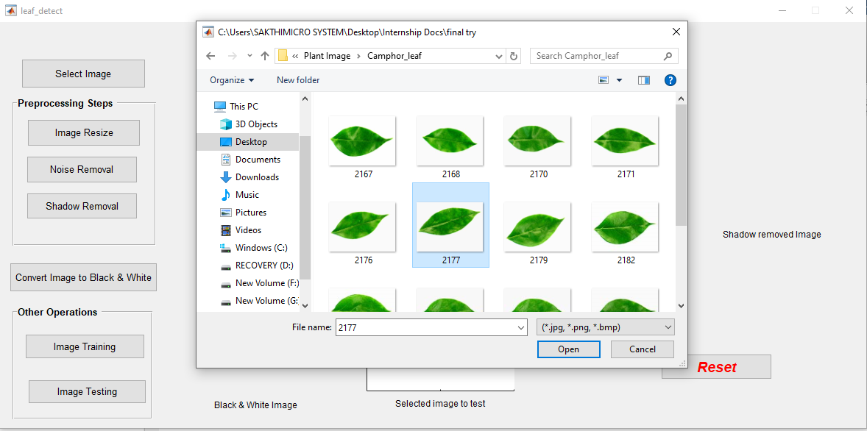
It shows the selection of image from dataset for testing purpose.

Slide 14
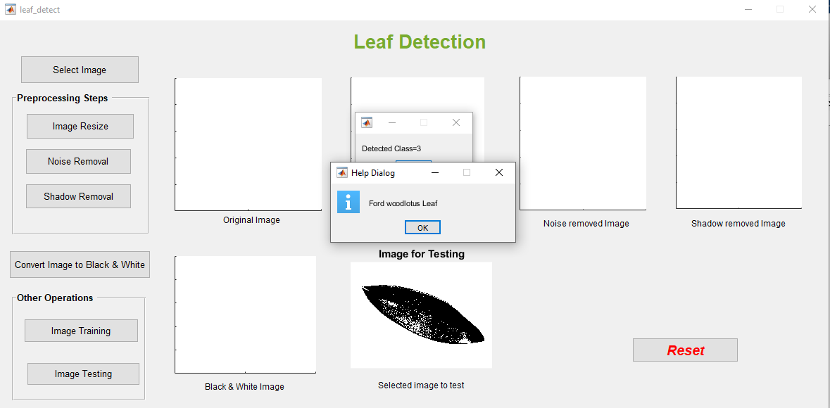
User can detect the plant leaf’s classes and names on the basis of their shapes.

Slide 15
Individual Contributions
A.Sivarajah (UWU/CST/16/047)
Design GUI & Select an image from dataset
Train the images to recognize their shapes
Perform the noise removal
L.Thanogika (UWU/CST/16/050)
Train the images to recognize their shapes
Test image to detect leaf’s name
Reset the images from GUI
A.Theepag (UWU/CST/16/052)
Train the images to recognize their shapes
Perform shadow removal from the image
Resize & Convert image from RGB to B&W

